Slide 1
Chapter 13
The bookstore website

Slide 2
Objectives
Applied
Use any of the techniques presented in the Bookstore website.
Knowledge
Describe why it’s generally considered a good practice to have a “fat” model and “skinny” controllers.
Describe how the Author Catalog page provides for paging and sorting.
Describe how the Book Catalog page provides for paging, sorting, and filtering.
Describe how the Cart page uses session state and cookies to store its data.
Describe how the Manage Books tab of the Admin page provides a feature for searching for books that’s also used by the Manage Genres tab.

Slide 3
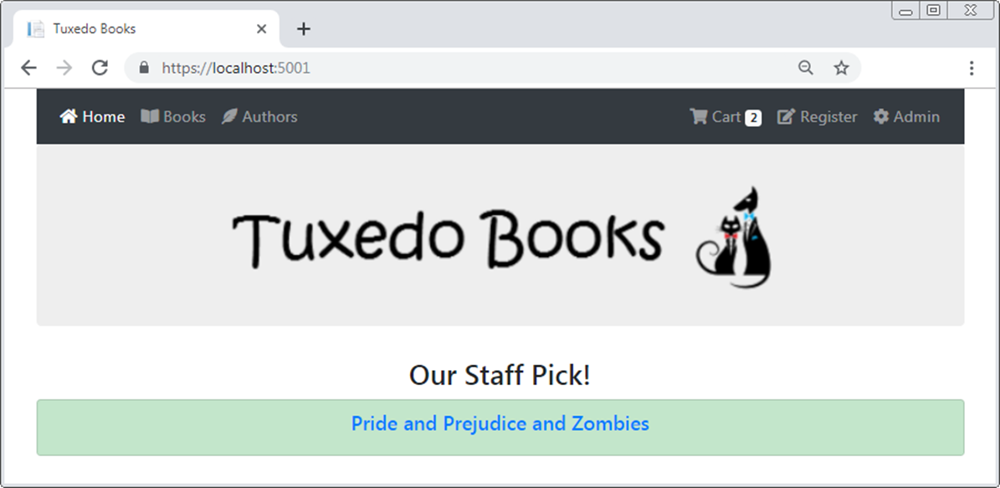
The Home page

Slide 4
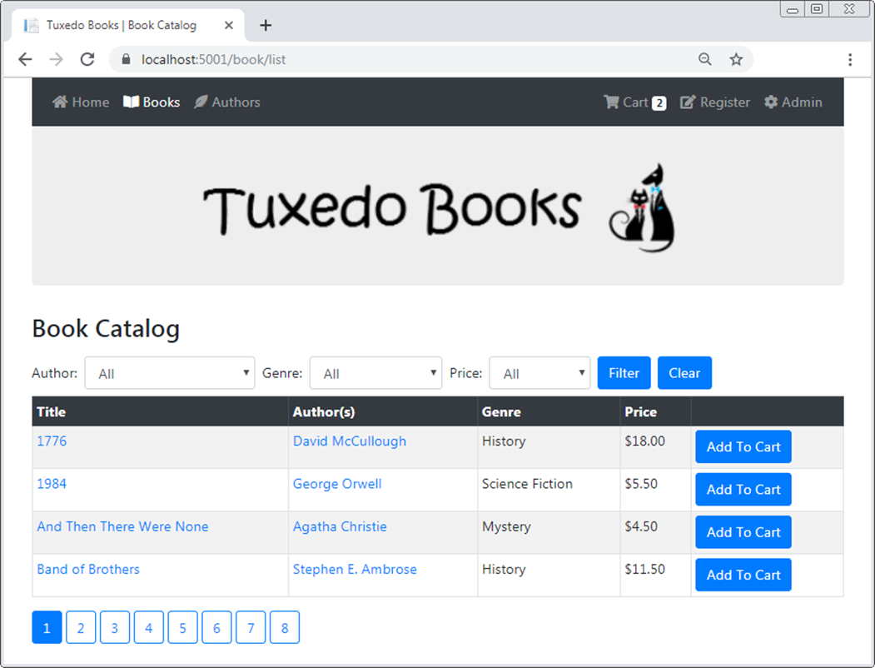
The Book Catalog page

Slide 5
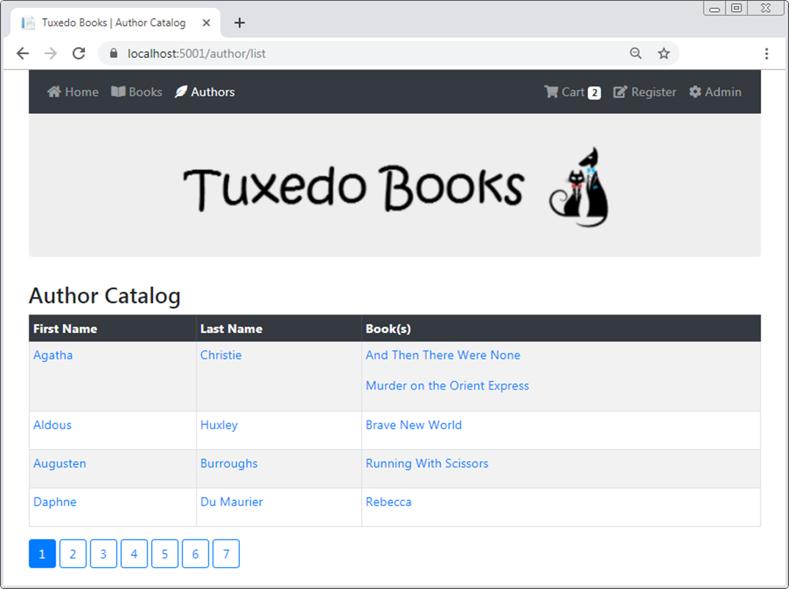
The Author Catalog page

Slide 6
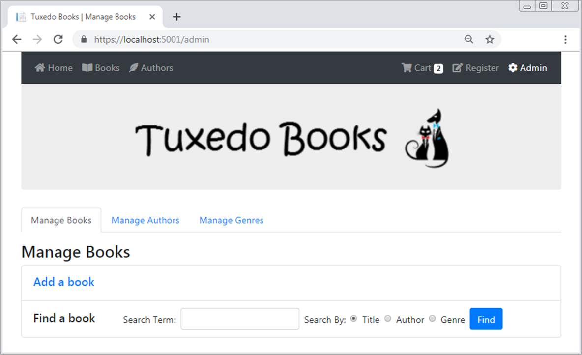
The Manage Books tab of the Admin page

Slide 7
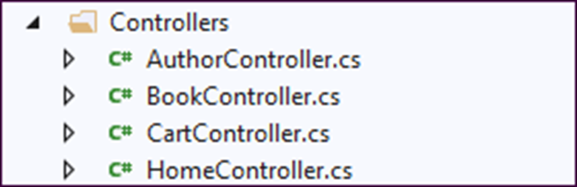
The Controllers folder

Slide 8
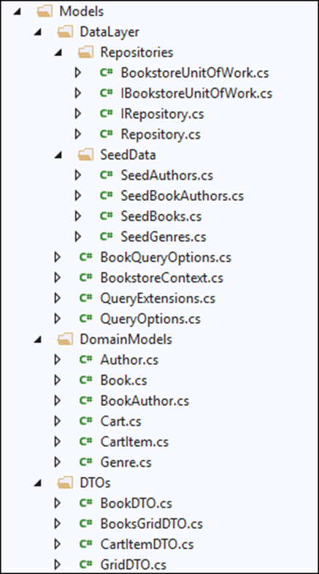
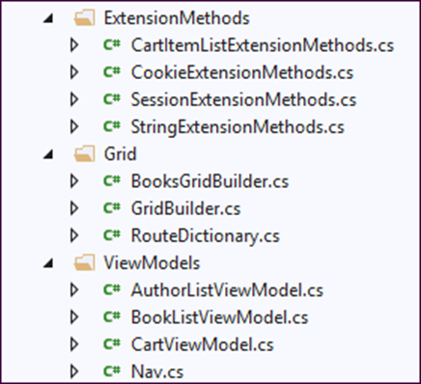
The Models folder and its subfolders

Slide 9
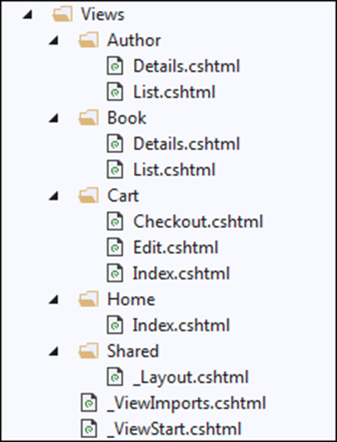
The Views folder

Slide 10
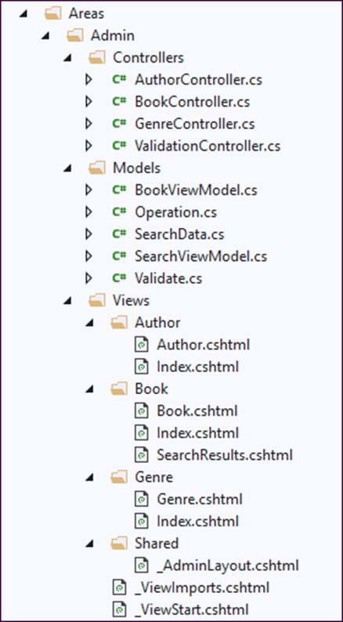
The Admin area folder and its subfolders

Slide 11
Extension methods for the ISession interface
using Microsoft.AspNetCore.Http;
using Newtonsoft.Json;
...
public static class SessionExtensions
{
public static void SetObject<T>(this ISession session,
string key, T value) =>
session.SetString(key,
JsonConvert.SerializeObject(value));
public static T GetObject<T>(this ISession session,
string key)
{
var value = session.GetString(key);
return value == null ? default(T) :
JsonConvert.DeserializeObject<T>(value);
}
}

Slide 12
Extension methods for the String class
public static class StringExtensions
{
public static string Slug(this string s) {
var sb = new StringBuilder();
foreach (char c in s) {
if (!char.IsPunctuation(c) || c == '-') {
sb.Append(c);
}
}
return sb.ToString().Replace(' ', '-').ToLower();
}
public static bool EqualsNoCase(this string s,
string tocompare) => s?.ToLower() == tocompare?.ToLower();
public static int ToInt(this string s) {
int.TryParse(s, out int id);
return id;
}
public static string Capitalize(this string s) =>
s?.Substring(0, 1)?.ToUpper() +
s?.Substring(1).ToLower();
}

Slide 13
The generic QueryOptions class (part 1)
public class QueryOptions<T>
{
public Expression<Func<T, Object>> OrderBy { get; set; }
public string OrderByDirection { get; set; } = "asc"; // default
public int PageNumber { get; set; }
public int PageSize { get; set; }
private string[] includes;
public string Includes {
set => includes = value.Replace(" ", "").Split(',');
}
public string[] GetIncludes() => includes ?? new string[0];
public WhereClauses<T> WhereClauses { get; set; }
public Expression<Func<T, bool>> Where {
set {
if (WhereClauses == null)
{
WhereClauses = new WhereClauses<T>();
}
WhereClauses.Add(value);
}
}

Slide 14
The generic QueryOptions class (part 2)
public bool HasWhere => WhereClauses != null;
public bool HasOrderBy => OrderBy != null;
public bool HasPaging => PageNumber > 0 && PageSize > 0;
}
public class WhereClauses<T> : List<Expression<Func<T, bool>>> {}

Slide 15
The generic Repository class (part 1)
public class Repository<T> : IRepository<T> where T : class
{
protected BookstoreContext context { get; set; }
private DbSet<T> dbset { get; set; }
public Repository(BookstoreContext ctx) {
context = ctx;
dbset = context.Set<T>();
}
private int? count;
public int Count => count ?? dbset.Count();
public virtual IEnumerable<T> List(QueryOptions<T> options) {
IQueryable<T> query = BuildQuery(options);
return query.ToList();
}
public virtual T Get(int id) => dbset.Find(id);
public virtual T Get(string id) => dbset.Find(id);
public virtual T Get(QueryOptions<T> options) {
IQueryable<T> query = BuildQuery(options);
return query.FirstOrDefault();
}
public virtual void Insert(T entity) => dbset.Add(entity);
public virtual void Update(T entity) => dbset.Update(entity);
public virtual void Delete(T entity) => dbset.Remove(entity);
public virtual void Save() => context.SaveChanges();

Slide 16
The generic Repository class (part 2)
private IQueryable<T> BuildQuery(QueryOptions<T> options)
{
IQueryable<T> query = dbset;
foreach (string include in options.GetIncludes()) {
query = query.Include(include);
}
if (options.HasWhere) {
foreach (var clause in options.WhereClauses) {
query = query.Where(clause);
}
count = query.Count(); // get filtered count
}
if (options.HasOrderBy){
if (options.OrderByDirection == "asc")
query = query.OrderBy(options.OrderBy);
else
query = query.OrderByDescending(options.OrderBy);
}
if (options.HasPaging)
query = query.PageBy(options.PageNumber,
options.PageSize);
return query;
}
}

Slide 17
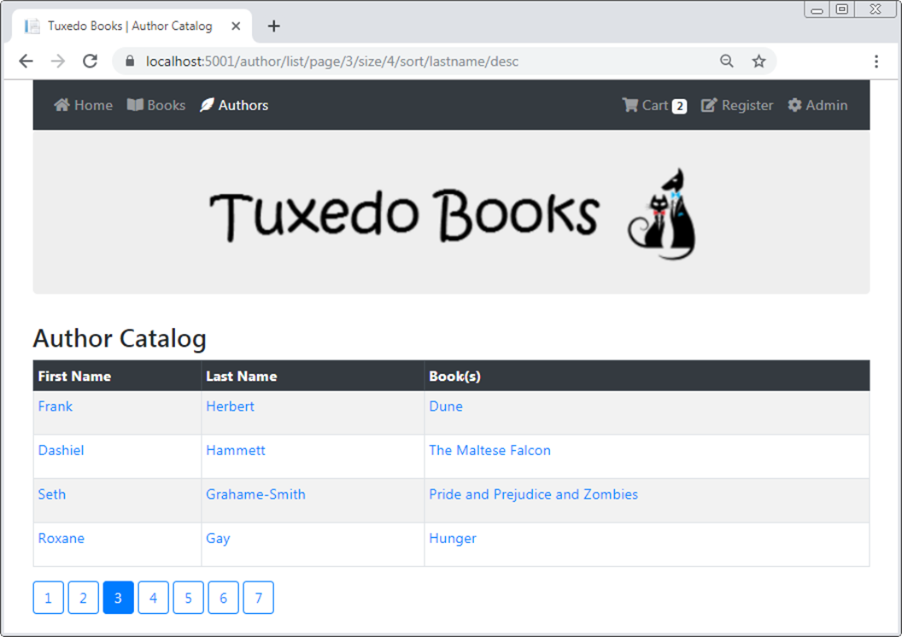
Page 3 of the Author Catalog sorted by last name in descending order

Slide 18
The URL for the Author Catalog page
https://localhost:5001/author/list/page/3/size/4/sort/
lastname/desc
The custom route in the Startup.cs file
endpoints.MapControllerRoute(
name: "",
pattern: "{controller}/{action}/page/{pagenumber}/size/{pagesize}/
sort/{sortfield}/{sortdirection}");

Slide 19
The GridDTO class with some default paging and sorting values
public class GridDTO {
public int PageNumber { get; set; } = 1;
public int PageSize { get; set; } = 4;
public string SortField { get; set; }
public string SortDirection { get; set; } = "asc";
}

Slide 20
The RouteDictionary class (part 1)
public class RouteDictionary : Dictionary<string, string>
{
public int PageNumber {
get => Get(nameof(GridDTO.PageNumber)).ToInt();
set => this[nameof(GridDTO.PageNumber)] = value.ToString();
}
public int PageSize {
get => Get(nameof(GridDTO.PageSize)).ToInt();
set => this[nameof(GridDTO.PageSize)] = value.ToString();
}
public string SortField {
get => Get(nameof(GridDTO.SortField));
set => this[nameof(GridDTO.SortField)] = value;
}
public string SortDirection {
get => Get(nameof(GridDTO.SortDirection));
set => this[nameof(GridDTO.SortDirection)] = value;
}

Slide 21
The RouteDictionary class (part 2)
private string Get(string key) =>
Keys.Contains(key) ? this[key] : null;
public void SetSortAndDirection(string fieldName,
RouteDictionary current)
{
this[nameof(GridDTO.SortField)] = fieldName;
if (current.SortField.EqualsNoCase(fieldName) &&
current.SortDirection == "asc")
this[nameof(GridDTO.SortDirection)] = "desc";
else
this[nameof(GridDTO.SortDirection)] = "asc";
}
public RouteDictionary Clone()
{
var clone = new RouteDictionary();
foreach (var key in Keys) {
clone.Add(key, this[key]);
}
return clone;
}
}

Slide 22
The GridBuilder class (part 1)
public class GridBuilder
{
private const string RouteKey = "currentroute";
protected RouteDictionary routes { get; set; }
private ISession session { get; set; }
// this constructor used when just need to get route data from the session
public GridBuilder(ISession sess) {
session = sess;
routes = session.GetObject<RouteDictionary>(RouteKey) ??
new RouteDictionary();
}
// this constructor used when need to store paging-sorting route segments
public GridBuilder(ISession sess, GridDTO values,
string defaultSortField) {
session = sess;
routes = new RouteDictionary(); // clear previous route segment values
routes.PageNumber = values.PageNumber;
routes.PageSize = values.PageSize;
routes.SortField = values.SortField ?? defaultSortField;
routes.SortDirection = values.SortDirection;
SaveRouteSegments();
}

Slide 23
The GridBuilder class (part 2)
public void SaveRouteSegments() =>
session.SetObject<RouteDictionary>(RouteKey, routes);
public int GetTotalPages(int count) {
int size = routes.PageSize;
return (count + size - 1) / size;
}
public RouteDictionary CurrentRoute => routes;
}

Slide 24
The Author/List view model
public class AuthorListViewModel
{
public IEnumerable<Author> Authors { get; set; }
public RouteDictionary CurrentRoute { get; set; }
public int TotalPages { get; set; }
}

Slide 25
The Author controller (part 1)
public class AuthorController : Controller
{
private Repository<Author> data { get; set; }
public AuthorController(BookstoreContext ctx) =>
data = new Repository<Author>(ctx);
public IActionResult Index() => RedirectToAction("List");
public ViewResult List(GridDTO vals)
{
// get GridBuilder object, load route segment values,
// store in session
string defaultSort = nameof(Author.FirstName);
var builder = new GridBuilder(HttpContext.Session,
vals, defaultSort);
// create options for querying authors
var options = new QueryOptions<Author> {
Includes = "BookAuthors.Book",
PageNumber = builder.CurrentRoute.PageNumber,
PageSize = builder.CurrentRoute.PageSize,
OrderByDirection = builder.CurrentRoute.SortDirection
};

Slide 26
The Author controller (part 2)
// OrderBy depends on value of SortField route
if (builder.CurrentRoute.SortField.EqualsNoCase(defaultSort))
options.OrderBy = a => a.FirstName;
else
options.OrderBy = a => a.LastName;
var vm = new AuthorListViewModel {
Authors = data.List(options),
CurrentRoute = builder.CurrentRoute,
TotalPages = builder.GetTotalPages(data.Count)
};
return View(vm);
}
public IActionResult Details(int id) {...}
}

Slide 27
The Author/List view (part 1)
@model AuthorListViewModel
@{
ViewData["Title"] = " | Author Catalog";
RouteDictionary current = Model.CurrentRoute;
RouteDictionary routes = Model.CurrentRoute.Clone();
}
<h1>Author Catalog</h1>
<table class="table table-bordered table-striped table-sm">
<thead class="thead-dark">
<tr>
<th>
@{ routes.SetSortAndDirection(nameof(Author.FirstName),
current); }
<a asp-action="List" asp-all-route-data="@routes"
class="text-white">First Name</a></th>
<th>
@{ routes.SetSortAndDirection(nameof(Author.LastName),
current); }
<a asp-action="List" asp-all-route-data="@routes"
class="text-white">Last Name</a></th>
<th>Books(s)</th>
</tr>
</thead>

Slide 28
The Author/List view (part 2)
<tbody>
@foreach (Author author in Model.Authors) {
<tr>
<td>
<a asp-action="Details" asp-route-id="@author.AuthorId"
asp-route-slug="@author.FullName.Slug()">
@author.FirstName</a>
</td>
<td>
<a asp-action="Details" asp-route-id="@author.AuthorId"
asp-route-slug="@author.FullName.Slug()">
@author.LastName</a>
</td>
<td>
@foreach (var ba in author.BookAuthors) {
<p>
<a asp-action="Details" asp-controller="Book"
asp-route-id="@ba.BookId"
asp-route-slug="@ba.Book.Title.Slug()">
@ba.Book.Title</a></p>
}
</td>
</tr>
}

Slide 29
The Author/List view (part 3)
</tbody>
</table>
@{
// reset to current route values
routes = Model.CurrentRoute.Clone();
for (int i = 1; i <= Model.TotalPages; i++) {
routes.PageNumber = i;
<a asp-action="List" asp-all-route-data="@routes"
class="btn btn-primary
@Nav.Active(i, current.PageNumber)">@i</a>
}
}

Slide 30
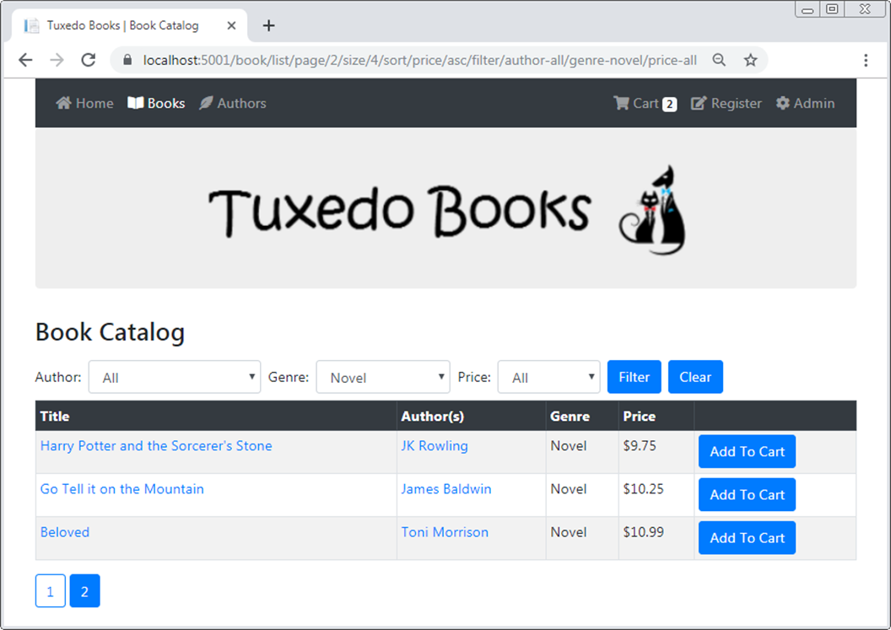
Page 2 of the Book Catalog filtered by the novel genre and sorted by price in ascending order

Slide 31
The route segments for the Book Catalog page
/page/2/size/4/sort/price/asc/filter/author-all/
genre-novel/price-all
The custom route in the Startup.cs file
endpoints.MapControllerRoute(
name: "",
pattern: "{controller=Home}/{action=Index}/
page/{pagenumber}/size/{pagesize}/
sort/{sortfield}/{sortdirection}/
filter/{author}/{genre}/{price}");

Slide 32
The BooksGridDTO class with default filtering values
using Newtonsoft.Json;
...
public class BooksGridDTO : GridDTO {
[JsonIgnore]
public const string DefaultFilter = "all";
public string Author { get; set; } = DefaultFilter;
public string Genre { get; set; } = DefaultFilter;
public string Price { get; set; } = DefaultFilter;
}

Slide 33
The static FilterPrefix class
public static class FilterPrefix
{
public const string Genre = "genre-";
public const string Price = "price-";
public const string Author = "author-";
}

Slide 34
The updated RouteDictionary class (part 1)
public class RouteDictionary : Dictionary<string, string>
{
// paging and sorting properties and methods here
public string GenreFilter {
get => Get(nameof(BooksGridDTO.Genre))?.Replace(
FilterPrefix.Genre, "");
set => this[nameof(BooksGridDTO.Genre)] = value;
}
public string PriceFilter {
get => Get(nameof(BooksGridDTO.Price))?.Replace(
FilterPrefix.Price, "");
set => this[nameof(BooksGridDTO.Price)] = value;
}

Slide 35
The updated RouteDictionary class (part 2)
public string AuthorFilter {
get {
string s = Get(nameof(BooksGridDTO.Author))?.Replace(
FilterPrefix.Author, "");
int index = s?.IndexOf('-') ?? -1;
return (index == -1) ? s : s.Substring(0, index);
}
set => this[nameof(BooksGridDTO.Author)] = value;
}
public void ClearFilters() =>
GenreFilter = PriceFilter = AuthorFilter =
BooksGridDTO.DefaultFilter;
}

Slide 36
The BooksGridBuilder class (part 1)
public class BooksGridBuilder : GridBuilder
{
// this constructor gets route data from session state
public BooksGridBuilder(ISession sess) : base(sess) { }
// this constructor stores filtering route segments, as
// well as paging and sorting segments stored by the
// base constructor
public BooksGridBuilder(ISession sess, BooksGridDTO values,
string defaultSortField) : base(sess, values, defaultSortField)
{
bool isInitial =
values.Genre.IndexOf(FilterPrefix.Genre) == -1;
routes.AuthorFilter = (isInitial) ?
FilterPrefix.Author + values.Author : values.Author;
routes.GenreFilter = (isInitial) ?
FilterPrefix.Genre + values.Genre : values.Genre;
routes.PriceFilter = (isInitial) ?
FilterPrefix.Price + values.Price : values.Price;
}

Slide 37
The BooksGridBuilder class (part 2)
public void LoadFilterSegments(string[] filter, Author author) {
if (author == null) {
routes.AuthorFilter = FilterPrefix.Author + filter[0];
} else {
routes.AuthorFilter = FilterPrefix.Author + filter[0]
+ "-" + author.FullName.Slug();
}
routes.GenreFilter = FilterPrefix.Genre + filter[1];
routes.PriceFilter = FilterPrefix.Price + filter[2];
}
public void ClearFilterSegments() => routes.ClearFilters();
// filter flags
string default = BooksGridDTO.DefaultFilter;
public bool IsFilterByAuthor => routes.AuthorFilter != default;
public bool IsFilterByGenre => routes.GenreFilter != default;
public bool IsFilterByPrice => routes.PriceFilter != default;
// sort flags
public bool IsSortByGenre =>
routes.SortField.EqualsNoCase(nameof(Genre));
public bool IsSortByPrice =>
routes.SortField.EqualsNoCase(nameof(Book.Price));
}

Slide 38
The BookQueryOptions class (part 1)
public class BookQueryOptions : QueryOptions<Book>
{
public void SortFilter(BooksGridBuilder builder)
{
if (builder.IsFilterByGenre) {
Where = b =>
b.GenreId == builder.CurrentRoute.GenreFilter;
}
if (builder.IsFilterByPrice) {
if (builder.CurrentRoute.PriceFilter == "under7")
Where = b => b.Price < 7;
else if (builder.CurrentRoute.PriceFilter == "7to14")
Where = b => b.Price >= 7 && b.Price <= 14;
else
Where = b => b.Price > 14;
}
if (builder.IsFilterByAuthor) {
int id = builder.CurrentRoute.AuthorFilter.ToInt();
if (id > 0)
Where = b => b.BookAuthors.Any(
a => a.Author.AuthorId == id);
}

Slide 39
The BookQueryOptions class (part 2)
if (builder.IsSortByGenre) {
OrderBy = b => b.Genre.Name;
}
else if (builder.IsSortByPrice) {
OrderBy = b => b.Price;
}
else {
OrderBy = b => b.Title;
}
}
}

Slide 40
The BookstoreUnitOfWork class
public class BookstoreUnitOfWork : IBookstoreUnitOfWork
{
private BookstoreContext context { get; set; }
public BookstoreUnitOfWork(BookstoreContext ctx) =>
context = ctx;
// properties for Books, Authors, BookAuthors,
// and Genres repositories
// helper methods for deleting current authors from existing
// book or loading book authors into a new book
public void Save() => context.SaveChanges();
}

Slide 41
The Book/List view model
public class BookListViewModel
{
public IEnumerable<Book> Books { get; set; }
public RouteDictionary CurrentRoute { get; set; }
public int TotalPages { get; set; }
// for filter drop-down data – one hard-coded
public IEnumerable<Author> Authors { get; set; }
public IEnumerable<Genre> Genres { get; set; }
public Dictionary<string, string> Prices =>
new Dictionary<string, string> {
{ "under7", "Under $7" },
{ "7to14", "$7 to $14" },
{ "over14", "Over $14" } };
}

Slide 42
The List() action method of the Book controller
public ViewResult List(BooksGridDTO values) {
var builder = new BooksGridBuilder(HttpContext.Session, values,
defaultSortField: nameof(Book.Title));
var options = new BookQueryOptions {
Include = "BookAuthors.Author, Genre",
OrderByDirection = builder.CurrentRoute.SortDirection,
PageNumber = builder.CurrentRoute.PageNumber,
PageSize = builder.CurrentRoute.PageSize
};
options.SortFilter(builder);
var vm = new BookListViewModel {
Books = data.Books.List(options),
Authors = data.Authors.List(new QueryOptions<Author> {
OrderBy = a => a.FirstName }),
Genres = data.Genres.List(new QueryOptions<Genre> {
OrderBy = g => g.Name }),
CurrentRoute = builder.CurrentRoute,
TotalPages = builder.GetTotalPages(data.Books.Count)
};
return View(vm);
}

Slide 43
The Filter() action method of the Book controller
[HttpPost]
public RedirectToActionResult Filter(string[] filter,
bool clear = false)
{
if (clear) {
builder.ClearFilterSegments();
}
else { // get author so you can add slug if needed
var author = data.Authors.Get(filter[0].ToInt());
builder.LoadFilterSegments(filter, author);
}
builder.SaveRouteSegments();
var builder = new BooksGridBuilder(HttpContext.Session);
return RedirectToAction("List", builder.CurrentRoute);
}

Slide 44
The Book/List view (part 1)
@model BookListViewModel
@{
ViewData["Title"] = " | Book Catalog";
RouteDictionary current = Model.CurrentRoute;
RouteDictionary routes = Model.CurrentRoute.Clone();
}
<h1>Book Catalog</h1>
<form asp-action="Filter" method="post" class="form-inline">
<label>Author: </label>
<select name="filter" class="form-control m-2"
asp-items="@(new SelectList(
Model.Authors, "AuthorId", "FullName",
current.AuthorFilter))">
<option value="@BooksGridDTO.DefaultFilter">All</option>
</select>

Slide 45
The Book/List view (part 2)
<label>Genre: </label>
<select name="filter" class="form-control m-2"
asp-items="@(new SelectList(
Model.Genres, "GenreId", "Name", current.GenreFilter))">
<option value="@BooksGridDTO.DefaultFilter">All</option>
</select>
<label>Price: </label>
<select name="filter" class="form-control m-2"
asp-items="@(new SelectList(
Model.Prices, "Key", "Value", current.PriceFilter))">
<option value="@BooksGridDTO.DefaultFilter">All</option>
</select>
<button type="submit" class="btn btn-primary mr-2">
Filter</button>
<button type="submit" class="btn btn-primary"
name="clear" value="true">Clear</button>
</form>
<form asp-action="Add" asp-controller="Cart" method="post">
<table class="table table-bordered table-striped table-sm">
<!-- table with column headers for sorting -->
</table>
</form>
@{ // Razor code block with paging links }

Slide 46
Extension methods for cookies (part 1)
using Microsoft.AspNetCore.Http;
using Newtonsoft.Json;
...
public static class CookieExtensions
{
public static string GetString(
this IRequestCookieCollection cookies, string key) =>
cookies[key];
public static int? GetInt32(
this IRequestCookieCollection cookies, string key) =>
int.TryParse(cookies[key], out int i) ? i : (int?) null;
public static T GetObject<T>(
this IRequestCookieCollection cookies, string key)
{
var value = cookies[key];
return value == null ? default(T) :
JsonConvert.DeserializeObject<T>(value);
}

Slide 47
Extension methods for cookies (part 2)
public static void SetString(this IResponseCookies cookies,
string key, string value, int days = 30) {
cookies.Delete(key); // delete old value first
if (days == 0) { // session cookie
cookies.Append(key, value);
}
else { // persistent cookie
CookieOptions options = new CookieOptions {
Expires = DateTime.Now.AddDays(days)
};
cookies.Append(key, value, options);
}
}
public static void SetInt32(this IResponseCookies cookies,
string key, int value, int days = 30) =>
cookies.SetString(key, value.ToString(), days);
public static void SetObject<T>(this IResponseCookies cookies,
string key, T value, int days = 30) =>
cookies.SetString(key, JsonConvert.SerializeObject(value),
days);
}

Slide 48
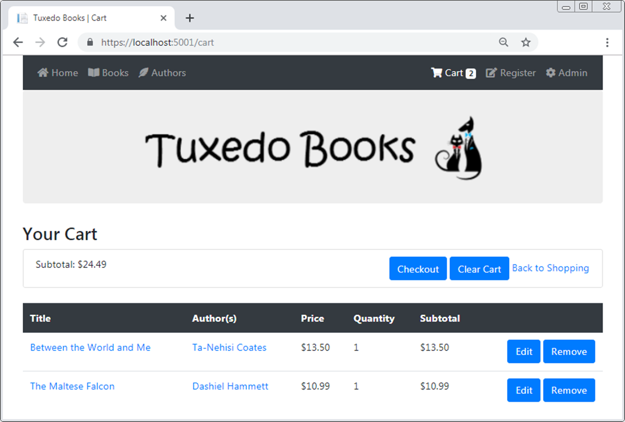
The Cart page

Slide 49
The CartItem class
using Newtonsoft.Json;
...
public class CartItem
{
public BookDTO Book { get; set; }
public int Quantity { get; set; }
[JsonIgnore]
public double Subtotal => Book.Price * Quantity;
}

Slide 50
The BookDTO class
public class BookDTO
{
public int BookId { get; set; }
public string Title { get; set; }
public double Price { get; set; }
public Dictionary<int, string> Authors { get; set; }
public void Load(Book book)
{
BookId = book.BookId;
Title = book.Title;
Price = book.Price;
Authors = new Dictionary<int, string>();
foreach (BookAuthor ba in book.BookAuthors) {
Authors.Add(ba.Author.AuthorId,
ba.Author.FullName);
}
}
}

Slide 51
The CartItemDTO class
public class CartItemDTO
{
public int BookId { get; set; }
public int Quantity { get; set; }
}

Slide 52
An extension method for a list of CartItem objects
public static class CartItemListExtensions
{
public static List<CartItemDTO> ToDTO(
this List<CartItem> list) =>
list.Select(ci => new CartItemDTO {
BookId = ci.Book.BookId,
Quantity = ci.Quantity
}).ToList();
}

Slide 53
The CartViewModel class
public class CartViewModel
{
public IEnumerable<CartItem> List { get; set; }
public RouteDictionary BookGridRoute { get; set; }
public double Subtotal { get; set; }
}

Slide 54
The Cart class (part 1)
public class Cart
{
private const string CartKey = "mycart";
private const string CountKey = "mycount";
private List<CartItem> items { get; set; }
private List<CartItemDTO> storedItems { get; set; }
private ISession session { get; set; }
private IRequestCookieCollection requestCookies { get; set; }
private IResponseCookies responseCookies { get; set; }
public Cart(HttpContext ctx) {
session = ctx.Session;
requestCookies = ctx.Request.Cookies;
responseCookies = ctx.Response.Cookies;
}

Slide 55
The Cart class (part 2)
public void Load(Repository<Book> data) {
items = session.GetObject<List<CartItem>>(CartKey);
if (items == null) {
items = new List<CartItem>();
storedItems =
requestCookies.GetObject<List<CartItemDTO>>(CartKey);
}
if (storedItems?.Count > items?.Count) {
foreach (CartItemDTO storedItem in storedItems) {
var book = data.Get(new QueryOptions<Book> {
Include = "BookAuthors.Author, Genre",
Where = b => b.BookId == storedItem.BookId
});
if (book != null) {
var dto = new BookDTO();
dto.Load(book);
CartItem item = new CartItem {
Book = dto,
Quantity = storedItem.Quantity
};
items.Add(item);
}
}
Save();
}
}

Slide 56
The Cart class (part 3)
public double Subtotal => items.Sum(c => c.Subtotal);
public int? Count => session.GetInt32(CountKey) ??
requestCookies.GetInt32(CountKey);
public IEnumerable<CartItem> List => items;
public CartItem GetById(int id) =>
items.FirstOrDefault(ci => ci.Book.BookId == id);
public void Add(CartItem item) {
var itemInCart = GetById(item.Book.BookId);
if (itemInCart == null) { // if new, add
items.Add(item);
}
else { // otherwise, increase quantity by 1
itemInCart.Quantity += 1;
}
}
public void Edit(CartItem item) {
var itemInCart = GetById(item.Book.BookId);
if (itemInCart != null) {
itemInCart.Quantity = item.Quantity;
}
}

Slide 57
The Cart class (part 4)
public void Remove(CartItem item) => items.Remove(item);
public void Clear() => items.Clear();
public void Save() {
if (items.Count == 0) {
session.Remove(CartKey);
session.Remove(CountKey);
responseCookies.Delete(CartKey);
responseCookies.Delete(CountKey);
}
else {
session.SetObject<List<CartItem>>(CartKey, items);
session.SetInt32(CountKey, items.Count);
responseCookies.SetObject<List<CartItemDTO>>(
CartKey, items.ToDTO());
responseCookies.SetInt32(CountKey, items.Count);
}
}
}

Slide 58
Some methods of the Cart controller (part 1)
private Cart GetCart() {
var cart = new Cart(HttpContext);
cart.Load(data);
return cart;
}
public ViewResult Index() {
Cart cart = GetCart();
var builder = new BooksGridBuilder(HttpContext.Session);
var vm = new CartViewModel {
List = cart.List,
Subtotal = cart.Subtotal,
BookGridRoute = builder.CurrentRoute
};
return View(vm);
}

Slide 59
Some methods of the Cart controller (part 2)
[HttpPost]
public RedirectToActionResult Add(int id) {
var book = data.Get(new QueryOptions<Book> {
Include = "BookAuthors.Author, Genre",
Where = b => b.BookId == id
});
if (book == null) {
TempData["message"] = "Unable to add book to cart.";
}
else {
var dto = new BookDTO();
dto.Load(book);
CartItem item = new CartItem {
Book = dto, Quantity = 1 // default quantity
};
Cart cart = GetCart();
cart.Add(item);
cart.Save();
TempData["message"] = $"{book.Title} added to cart";
}
var builder = new BooksGridBuilder(HttpContext.Session);
return RedirectToAction(
"List", "Book", builder.CurrentRoute);
}

Slide 60
Some methods of the Cart controller (part 3)
[HttpPost]
public RedirectToActionResult Remove(int id) {
Cart cart = GetCart();
CartItem item = cart.GetById(id);
cart.Remove(item);
cart.Save();
TempData["message"] =
$"{item.Book.Title} removed from cart.";
return RedirectToAction("Index");
}
// Edit(), Clear(), and Checkout() methods not shown here

Slide 61
The Cart/Index view (part 1)
@model CartViewModel
<h1>Your Cart</h1>
<form asp-action="Clear" method="post">
<ul class="list-group mb-4">
<li class="list-group-item">
<div class="row">
<div class="col">Subtotal: @Model.Subtotal.ToString("c")
</div>
<div class="col">
<div class="float-right">
<a asp-action="Checkout" class="btn btn-primary">
Checkout</a>
<button type="submit" class="btn btn-primary">
Clear Cart</button>
<a asp-action="List" asp-controller="Book"
asp-all-route-data="@Model.BookGridRoute">
Back to Shopping</a>
</div>
</div>
</div>
</li>
</ul>
</form>

Slide 62
The Cart/Index view (part 2)
<form asp-action="Remove" method="post">
<table class="table">
<thead class="thead-dark">
<tr><th>Title</th>
<th>Author(s)</th>
<th>Price</th>
<th>Quantity</th>
<th>Subtotal</th>
<th></th>
</tr>
</thead>
<tbody>
@foreach (CartItem item in Model.List) {
<tr>
<td>
<a asp-action="Details" asp-controller="Book"
asp-route-id="@item.Book.BookId"
asp-route-slug="@item.Book.Title.Slug()">
@item.Book.Title
</a>
</td>

Slide 63
The Cart/Index view (part 3)
<td>
@foreach (var keyValuePair in item.Book.Authors) {
<p><a asp-action="Details"
asp-controller="Author"
asp-route-id="@keyValuePair.Key"
asp-route-slug=
"@keyValuePair.Value.Slug()">
@keyValuePair.Value</a></p>
}
</td>
<!-- cells that display price, quantity, subtotal -->
<td>
<div class="float-right">
<a asp-action="Edit" asp-controller="Cart"
asp-route-id="@item.Book.BookId"
asp-route-slug="@item.Book.Title.Slug()"
class="btn btn-primary">Edit</a>
<button type="submit" name="id"
value="@item.Book.BookId"
class="btn btn-primary">Remove</button>
</div></td></tr>
}
</tbody></table>
</form>

Slide 64

The Manage Books tab of the Admin page for searching books

Slide 65
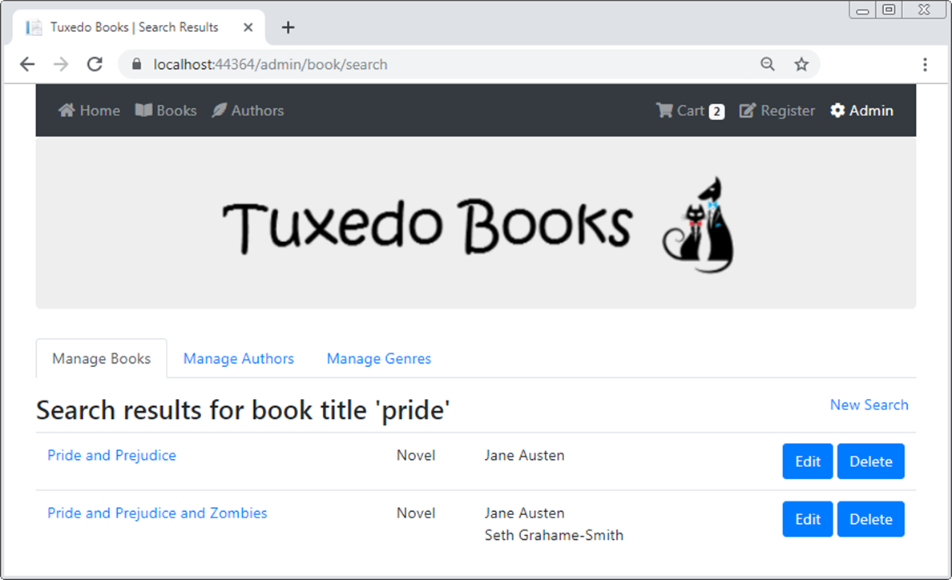
The Manage Books tab with search results

Slide 66
The SearchData class (part 1)
using Microsoft.AspNetCore.Mvc.ViewFeatures;
...
public class SearchData
{
private const string SearchKey = "search";
private const string TypeKey = "searchtype";
private ITempDataDictionary tempData { get; set; }
public SearchData(ITempDataDictionary temp) =>
tempData = temp;
// use Peek() rather than a straight read so value will persist
public string SearchTerm {
get => tempData.Peek(SearchKey)?.ToString();
set => tempData[SearchKey] = value;
}
public string Type {
get => tempData.Peek(TypeKey)?.ToString();
set => tempData[TypeKey] = value;
}

Slide 67
The SearchData class (part 2)
public bool HasSearchTerm => !string.IsNullOrEmpty(SearchTerm);
public bool IsBook => Type.EqualsNoCase("book");
public bool IsAuthor => Type.EqualsNoCase("author");
public bool IsGenre => Type.EqualsNoCase("genre");
public void Clear() {
tempData.Remove(SearchKey);
tempData.Remove(TypeKey);
}
}

Slide 68
The SearchViewModel class
using System.ComponentModel.DataAnnotations;
...
public class SearchViewModel
{
public IEnumerable<Book> Books { get; set; }
[Required(ErrorMessage = "Please enter a search term.")]
public string SearchTerm { get; set; }
public string Type { get; set; }
public string Header { get; set; }
}

Slide 69
The Search() action methods of the Book controller (part 1)
[HttpPost]
public RedirectToActionResult Search(SearchViewModel vm) {
if (ModelState.IsValid) {
var search = new SearchData(TempData) {
SearchTerm = vm.SearchTerm,
Type = vm.Type
};
return RedirectToAction("Search");
}
else {
return RedirectToAction("Index");
}
}

Slide 70
The Search() action methods (part 2)
[HttpGet]
public ViewResult Search() {
var search = new SearchData(TempData);
if (search.HasSearchTerm) {
var vm = new SearchViewModel {
SearchTerm = search.SearchTerm
};
var options = new QueryOptions<Book> {
Include = "Genre, BookAuthors.Author"
};
if (search.IsBook) {
options.Where = b => b.Title.Contains(vm.SearchTerm);
vm.Header =
$"Search results for book title '{vm.SearchTerm}'";
}

Slide 71
The Search() action methods (part 3)
if (search.IsAuthor) {
int index = vm.SearchTerm.LastIndexOf(' ');
if (index == -1) {
options.Where = b => b.BookAuthors.Any(
ba => ba.Author.FirstName.Contains(
vm.SearchTerm) ||
ba.Author.LastName.Contains(vm.SearchTerm));
}
else {
string first = vm.SearchTerm.Substring(0, index);
string last = vm.SearchTerm.Substring(index + 1);
options.Where = b => b.BookAuthors.Any(
ba => ba.Author.FirstName.Contains(first) &&
ba.Author.LastName.Contains(last));
}
vm.Header =
$"Search results for author '{vm.SearchTerm}'";
}

Slide 72
The Search() action methods (part 4)
if (search.IsGenre) {
options.Where = b =>
b.GenreId.Contains(vm.SearchTerm);
vm.Header =
$"Search results for genre ID '{vm.SearchTerm}'";
}
vm.Books = data.Books.List(options);
return View("SearchResults", vm);
}
else {
return View("Index");
}
}

Slide 73
The Delete() action method of the Genre controller
[HttpGet]
public IActionResult Delete(string id) {
var genre = data.Get(new QueryOptions<Genre> {
Include = "Books",
Where = g => g.GenreId == id
});
if (genre.Books.Count > 0) {
TempData["message"] = $"Can't delete genre {genre.Name} "
+ "because it's associated with these books.";
return GoToBookSearchResults(id);
}
else {
return View("Genre", genre);
}
}

Slide 74
The helper method of the Genre controller
private RedirectToActionResult GoToBookSearchResults(string id)
{
// display search results of all books in this genre
var search = new SearchData(TempData) {
SearchTerm = id,
Type = "genre"
};
return RedirectToAction("Search", "Book");
}

